Slide 1
Making this resource work for you
Prior to teaching this lesson, please refer to the ‘Unit Overview and Planning Document’.
Further guidance on planning Science Mastery lessons can be found in the detailed planning guidance document.
Refer to the ‘notes’ section on each slide for useful information, including suggested expositions, pedagogical content knowledge, suggested questions, answers and more. Consider using presenter mode so you can see this guidance throughout the lesson.
The introduction slides can be adapted to suit your teaching style and the needs of your class.
Before the lesson, adapt the fix-it slide to address any misconceptions identified in the previous lesson’s exit ticket.
Choose from the suggested activities to suit your class. The intention is not that you complete all of these, but that you select those which ones are most appropriate for your students. It may be appropriate to further adapt activities for your students.
These lessons are designed to occupy approximately 1 hour. To adapt for a shorter or longer lesson duration we advise you to adapt the activity section accordingly.
Please consider using the final slide to send feedback about this lesson or examples of PowerPoints that you have adapted to our design team. Your feedback is used to improve Science Mastery for all of our teachers and students. We appreciate all suggestions and comments.
Thank you for reading!
The Science Mastery Team

Slide 2

Taking it Further: Producing Ethanol from Ethene
Answer the questions below.
State the chemical formula of ethanol.
Explain why fermentation is an anaerobic process.
Describe the conditions needed for fermentation.
State the general formula of the alkenes.
Describe how bromine water can be used to tell the difference between an alkane and an alkene.
C₂H₅OH
It takes place in the absence of oxygen.
No oxygen, a sugar solution mixed with yeast, temperature of 25-35 ºC
C_{n}H_{2n}
Using bromine water, which would turn from orange to colourless when added to an alkene but remain orange when added to an alkane.
Notes:
Big idea: Reactions rearrange matter
Foundation: State the chemical formula for ethene.
Stretch: Explain the disadvantages of producing ethanol by fermentation.
Answers:
Foundation: C₂H₄
Stretch: It is a slow process and produces ethanol with low purity.

Slide 3
Taking it Further: Producing Ethanol from Ethene
Do Now:
State the chemical formula of ethanol.
Explain why fermentation is an anaerobic process.
Describe the conditions needed for fermentation.
State the general formula of the alkenes.
Describe how bromine water can be used to tell the difference between an alkane and an alkene.
Drill:
Draw the structural formula for ethene.
Name the product formed when ethene reacts with hydrogen.
Describe a condition needed for ethene to react with hydrogen.
Notes:
Drill answers:
drawn out ethene
Ethane
A catalyst is required

Slide 4
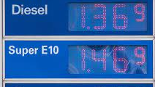
Taking it Further: Producing Ethanol from Ethene
Read Now:
Ethanol can be added to petrol for use as fuel for vehicles. This has become much more common since the 1990s, but particularly since 2005. Most petrol that you find at petrol stations is labelled ‘E10’, which means that it contains at least 10% ethanol. This is thought to slightly reduce the effects of burning fossil fuels on global warming, but only if the ethanol is produced through fermentation. This is when crops are grown as biofuels and therefore absorb carbon dioxide while they are growing. However, often ethanol is made from ethene, which is not a renewable resource as it is obtained from crude oil through fractional distillation and cracking.
Give a use of ethanol other than in alcoholic drinks.
Explain what is meant by E10 petrol.
Explain why ethanol obtained from fermentation is a renewable resource.
Explain why ethanol obtained from ethene is not a renewable resource.

Slide 5
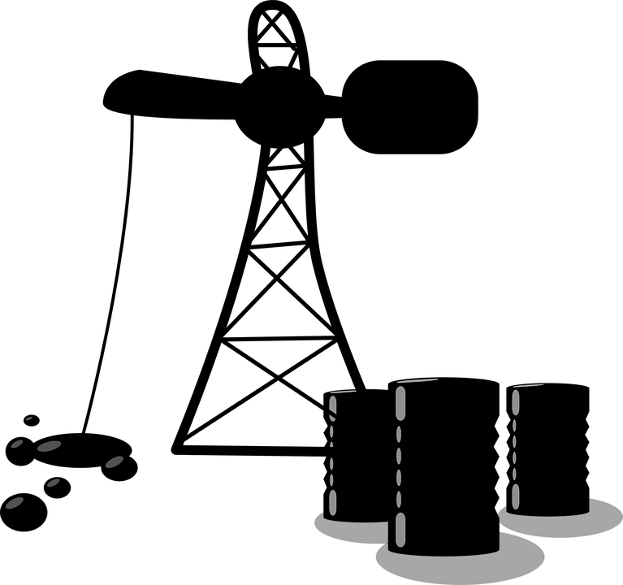
C5.1.9
15/08/2024
Taking it Further: Producing Ethanol from Ethene
C5.1.1 Prior Knowledge Review
C5.1.2 Crude Oil and Hydrocarbons
C5.1.3 Fractional Distillation
C5.1.4 Combustion of Hydrocarbons
C5.1.5 Cracking
C5.1.6 Taking it Further: Alkenes
C5.1.7 Taking it Further: Alcohols
C5.1.8 Taking it Further: Producing Ethanol by Fermentation
C5.1.9 Taking it Further: Producing Ethanol from Ethene
C5.1.10 Taking it Further: Carboxylic Acids
C5.1.11 Taking it Further: Esters
C5.1.12 Polymers
C5.1.13 Taking it Further: Addition Polymerisation
C5.1.14 Taking it Further: Condensation Polymerisation
C5.1.15 Taking it Further: Naturally Occurring Polymers
Notes:
Big Idea: Structure Determines Properties
In this lesson, students will look at the other method of producing ethanol and practise the skill of evaluating production methods.
Suggested Hook:
What are the advantages and disadvantages of making ethanol from fermentation?

Slide 6

Following this lesson, students will be able to:
Describe how ethanol can be made from ethene
Describe the conditions required for hydration of ethene
Evaluate the advantages and disadvantages of different methods of ethanol production
Key Words:
ethanol
ethene
hydration
catalyst
continuous
Notes:
Guidance:
See unit overview document and planning guidance to see how these objectives are typically assessed at GCSE, including examples of what students should be able to do following this lesson.
Planning for different needs:
The learning objectives given on this slide are suggested based on the most common requirements for exams, however they can be adapted based on the needs of different classes.
For best practice, the unit preparation booklet should be used to determine the appropriate focus of lessons within the unit.
While it is not possible to explicitly split content into levelled grades, we recommend that lesson objectives can be classified as critical, core or stretch.
Critical: the content or skill is essential for all students to be able to progress.
Core: the content or skill is important for students to progress, but other opportunities may be available to revisit it.
Stretch: the content or skill may not be essential for all students but is important for students aiming for the highest grades.
Key skill: this is a crucial skill being developed in this unit as part of the skill mapping
C5.1.9 Lesson Objectives:
Critical: Describe how ethanol can be made from ethene
Critical: Describe the conditions required for hydration of ethene
Core: Evaluate the advantages and disadvantages of different methods of ethanol production

Slide 7
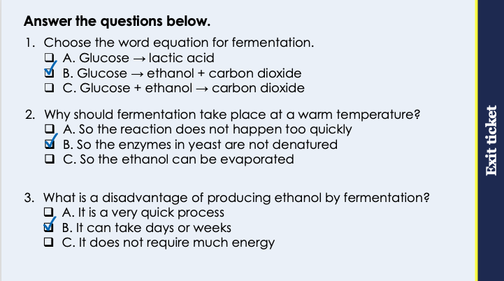
This is the fix-it portion of the lesson
The fix-it is an opportunity to respond to gaps in knowledge, especially those identified by the pre-unit quiz.
The teacher should customise this slide as needed, to facilitate
reteach, explanation, demonstration or modelling of ideas and concepts that students have not yet grasped or have misunderstood.
practise answering specific questions or of key skills.
redrafting or improving previous work.
Notes:
Purpose: to spend time on any gaps identified in previous learning from previous exit ticket.
Guidance from previous exit ticket:
Q1. Answer: B
If students answer A, they have not identified the importance of the hydroxyl group. If students answer C, they have confused the formulae of methanol and ethanol. To fix it, review the general formula for the alcohols and the naming conventions.
Q2. Answer: B
If students answer A, they have confused the use of methanol and ethanol. If students answer C, they have confused the use of methanol with propanol and butanol. To fix it, review what each of the alcohols is useful for.
Q3. Answer: B
If students answer A, they have not identified the correct pattern. If students answer C, they have not understood the difference between reactivity and solubility. To fix it, review what is meant by solubility and the pattern of solubility in the alcohols.

Slide 8
Ethanol
Ethanol is an alcohol.
Ethanol
C₂H₅OH
It is useful as a solvent, a fuel or in alcoholic drinks.
H
H
H
C
C
O
H
It can be made in different ways:
Fermentation
Hydration of ethene
H
H
Notes:
Suggested exposition:
In the last lesson, we looked at how ethanol can be made using fermentation.
What is ethanol used for?
In alcoholic drinks, solvents or as a fuel.
What happens in fermentation?
Microorganisms (such as yeast) start to break down glucose in the absence of oxygen.
In this lesson, we will look at another method of producing ethanol: hydration of ethene.
What does the word hydrated mean?
Water added.
This is exactly what hydrated means in the context of chemistry as well. Hydration of ethene means the addition of water to ethene.

Slide 9
Producing Ethanol
Alkenes can react with water through hydration.
Ethene
Water
Ethanol
H
H
H
H
C
C
+
H
H
→
H
C
C
O
H
H
H
H
H
C₂H₄ + H₂O → C₂H₅OH
Ethene for this reaction is obtained from crude oil, through fractional distillation and cracking.
Notes:
Suggested exposition:
We saw in the lesson on alkenes that alkenes can take part in addition reactions, such as with bromine or hydrogen, in hydrogenation. Alkenes can also react with water through hydration, which is also an addition reaction. The double bond is broken open and new bonds are formed with the atoms from water.
The equation for this reaction is: ethene + water → ethanol
The symbol equation for this is C₂H₄ + H₂O → C₂H₅OH
The ethene for the reaction is obtained from crude oil, through distillation and cracking. This means that the raw material used for it is a non-renewable resource.

Slide 10
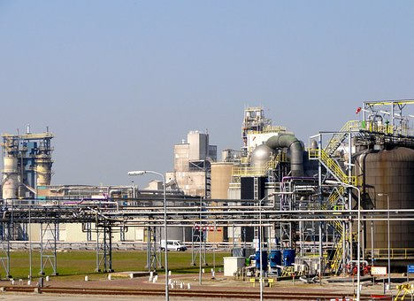
Conditions for Hydration
There are several conditions required for alkenes, such as ethene, to be hydrated.
The reaction requires a high temperature (approximately 300 ºC)
There needs to be a catalyst, for ethene → ethanol it is phosphoric acid
The pressure needs to be 60-70 atmospheres
As the temperature is high, the alkene actually reacts with water vapour (steam):
Ethene + steam → ethanol
Notes:
Suggested exposition:
For hydration of alkenes to take place, including the production of ethanol from ethene, several conditions are required.
It has to take place at high temperatures, which means the water in the reaction is water vapour (steam).
The reaction also takes place in the presence of a catalyst, which is phosphoric acid, to speed up the reaction.
There needs to be a pressure of 60-70 atmospheres
As the reaction takes place at a high temperature, water is in the gaseous form. This means that the alkene (ethene) is actually reacting with steam. The chemical formula is still H₂O.
Ethanol is the only product of this reaction
This is a continuous reaction, which means that as long as ethene and steam are fed into the reaction, ethanol will be produced continually. This makes it an efficient process.
Image from pixabay

Slide 11
Reverse Reaction
The reaction can also be reversed.
This means that ethanol can be converted back to ethene:
Ethanol → ethene + steam
C₂H₅OH → C₂H₄ + H₂O
The rate of this reaction can be increased using aluminium oxide as a catalyst.
Notes:
Suggested exposition:
The reaction of ethene with steam can be reversed, allowing ethanol to be converted back to ethene.
The word equation for this reaction is ethanol → ethene + steam
The chemical equation for this reaction is C₂H₅OH → C₂H₄ + H₂O
A catalyst called aluminium oxide can speed up this reaction.

Slide 12




Which statements do you agree with?
Producing ethanol from ethene uses a non- renewable raw material
Producing ethanol from ethene uses a renewable raw material
Producing ethanol from ethene requires a lot of energy
Producing ethanol from ethene does not require a lot of energy
Notes:
Suggested points:
Blue: incorrect
Yellow: correct
Green: correct
Pink: incorrect
Suggested guidance:
Talk tasks can be used in a variety of ways to suit the particular needs of the students you are teaching. Through exchanging views with others, students develop their understanding of the science beyond what could be achieved individually.
Science classrooms that successfully integrate talk have the following features:
Science talk is a regular feature of lessons and is woven into classroom activities.
Students are paired or grouped strategically by the teacher to ensure productive interaction. This might take into consideration the students’ proficiency of the English language, how encouraging they might be to peers and their attainment in the topic. It’s a good idea to consider these pairings in the class seating plan.
Students are encouraged and supported to talk, but are not forced to talk.
The teacher should take on the role of a facilitator, engaging with conversations where necessary and encouraging or steering the conversation where needed.
Students are encouraged to use the language they have to express their ideas (e.g., everyday language, imperfect English, native language), but also to incorporate science specific terminology where this is more accurate or has been taught.
6. Scientifically inaccurate ideas are not dismissed by the partner or teacher; open discussion and further investigation are relied on to help students construct ideas that support them to progress in their scientific understanding.
7. Guidelines for behaviour during talk tasks are explicit and frequently reviewed. Rules for students might be:
Listen carefully to your partner
Take turns talking.
Speak one at a time, without interrupting.
Politely agree or disagree and explain why.
Politely point out if your partner has used a scientific word incorrectly, if they have explained the science incorrectly, or if there is a more accurate way to describe something.
If confused, ask questions.
Stay focused on the discussion topic.
Respond to one another.

Slide 13

Can you explain the difference between these two processes?
Hydration
What are the reactants of each?
What are the products of each?
What conditions are needed for each?
Hydrogenation
Notes:
Suggested points:
Both involve the double bond of ethene (or another alkene) being broken.
Both are addition reactions
Hydration is the addition of water, hydrogenation is the addition of water
Hydration requires a catalyst
Hydrogenation requires steam/a high temperature and a catalyst
Suggested guidance:
Talk tasks can be used in a variety of ways to suit the particular needs of the students you are teaching. Through exchanging views with others, students develop their understanding of the science beyond what could be achieved individually.
Science classrooms that successfully integrate talk have the following features:
Science talk is a regular feature of lessons and is woven into classroom activities.
Students are paired or grouped strategically by the teacher to ensure productive interaction. This might take into consideration the students’ proficiency of the English language, how encouraging they might be to peers and their attainment in the topic. It’s a good idea to consider these pairings in the class seating plan.
Students are encouraged and supported to talk, but are not forced to talk.
The teacher should take on the role of a facilitator, engaging with conversations where necessary and encouraging or steering the conversation where needed.
Students are encouraged to use the language they have to express their ideas (e.g., everyday language, imperfect English, native language), but also to incorporate science specific terminology where this is more accurate or has been taught.
6. Scientifically inaccurate ideas are not dismissed by the partner or teacher; open discussion and further investigation are relied on to help students construct ideas that support them to progress in their scientific understanding.
7. Guidelines for behaviour during talk tasks are explicit and frequently reviewed. Rules for students might be:
Listen carefully to your partner
Take turns talking.
Speak one at a time, without interrupting.
Politely agree or disagree and explain why.
Politely point out if your partner has used a scientific word incorrectly, if they have explained the science incorrectly, or if there is a more accurate way to describe something.
If confused, ask questions.
Stay focused on the discussion topic.
Respond to one another.

Slide 14
Determine whether each of these statements is true or false
Ethene can be made by hydrating ethanol
Hydration involves the addition of water
Hydration of ethene requires a high temperature and pressure
The reaction can be continuous if steam and ethene are continually added
Hydration takes longer than fermentation
Ethene comes from crude oil
False
True
True
True
False
True

Slide 15
Drill
State the chemical formula of ethanol.
State the chemical formula of ethene.
Describe two methods of producing ethanol.
Describe how ethene is obtained from crude oil.
Explain whether ethene is a renewable or non-renewable resource.
Describe the conditions required for hydration of ethene.
State the word equation for the hydration of ethene.
State the chemical equation for the hydration of ethene.
State the general equation for the hydration of alkenes.
Describe the conditions required for the hydration of alkenes.
Explain why the alkenes are unsaturated.
Notes:
Purpose: This is a knowledge drill. The purpose of this is to check that the critical knowledge is secure before pupils move onto independent practice.
Suggested guidance: There are a range of ways this could be done depending on time and ability range of the class:
Mini whiteboards
As full sentences in exercise books
As short answers in exercise books
In the pupil workbook
As pair talk
As cold call

Slide 16
Drill answers
C₂H₅OH
C₂H₄
Hydration of ethene and fermentation
Through fractional distillation of crude oil then cracking
Non-renewable, as it is obtained from crude oil, which is not replenished at the same rate that it is used
A high temperature (around 300 ºC), 60-70 atm of pressure and a catalyst (phosphoric acid)
Ethene + steam → ethanol
C₂H₄ + H₂O → C₂H₅OH
Alkene + water (steam) → alcohol
High temperature and a catalyst
They contain a C=C double bond
Notes:
Purpose: This is a knowledge drill. The purpose of this is to check that the critical knowledge is secure before pupils move onto independent practice.
Suggested guidance: There are a range of ways this could be done depending on time and ability range of the class:
Mini whiteboards
As full sentences in exercise books
As short answers in exercise books
In the pupil workbook
As pair talk
As cold call

Slide 17
I: Evaluating Methods of Ethanol Production
Describe the advantages of producing ethanol by hydration of ethene.
Hydration has a higher rate of reaction than fermentation so ethanol can be produced faster
Hydration produces ethanol with higher purity than fermentation, which means it is less likely to need to be distilled
Method | Fermentation | Hydration of ethene
Rate of reaction | Low | High
Purity of ethanol produced | 10-15% | >95%
Energy usage | Low | High
Raw material used | Sugar | Crude oil
Notes:
Purpose: The I-We-You section aims to support pupils to build skills that they most commonly need when answering questions associated with this knowledge in the assessment. This section is also used to interleave other content we expect pupils to know at this stage of their education in order that they build a big picture of the science they are learning.
For the ‘I’ activity, the teacher should model how to answer the question. They can do this by narrating their thinking process aloud, and making links to learning earlier in the lesson explicit.
For the ‘we’ activity, the teacher and students work though a similar example together, in order to prepare students to be able to answer a similar question independently.
Opportunities for the ‘you’ activity – independent practise – occur in the activity portion of the lesson once the student is secure enough to process independently.

Slide 18
We: Evaluating Methods of Ethanol Production
Describe the disadvantages of producing ethanol by hydration of ethene.
Hydration uses more energy than fermentation, which means it is more expensive.
Hydration uses crude oil as a raw material which is non-renewable, whereas fermentation uses sugar, which is renewable.
Method | Fermentation | Hydration of ethene
Rate of reaction | Low | High
Purity of ethanol produced | 10-15% | >95%
Energy usage | Low | High
Raw material used | Sugar | Crude oil
Notes:
Purpose: The I-We-You section aims to support pupils to build skills that they most commonly need when answering questions associated with this knowledge in the assessment. This section is also used to interleave other content we expect pupils to know at this stage of their education in order that they build a big picture of the science they are learning.
For the ‘I’ activity, the teacher should model how to answer the question. They can do this by narrating their thinking process aloud, and making links to learning earlier in the lesson explicit.
For the ‘we’ activity, the teacher and students work though a similar example together, in order to prepare students to be able to answer a similar question independently.
Opportunities for the ‘you’ activity – independent practise – occur in the activity portion of the lesson once the student is secure enough to process independently.

Slide 19
You: Evaluating Methods of Ethanol Production
Evaluate which method of ethanol production is better for a company.
Hydration has a higher rate of reaction than fermentation so ethanol can be produced faster. However, hydration uses more energy so is a more expensive process.
Hydration produces ethanol with higher purity than fermentation, which means it is less likely to need to be distilled. However, hydration uses crude oil, which is a non-renewable resource, unlike fermentation, which uses a renewable resource.
Overall, I think that hydration would be better for a company because although it uses non-renewable resources, it allows ethanol to be produced more quickly.
Method | Fermentation | Hydration of ethene
Rate of reaction | Low | High
Purity of ethanol produced | 10-15% | >95%
Energy usage | Low | High
Raw material used | Sugar | Crude oil
Notes:
Purpose: The I-We-You section aims to support pupils to build skills that they most commonly need when answering questions associated with this knowledge in the assessment. This section is also used to interleave other content we expect pupils to know at this stage of their education in order that they build a big picture of the science they are learning.
For the ‘I’ activity, the teacher should model how to answer the question. They can do this by narrating their thinking process aloud, and making links to learning earlier in the lesson explicit.
For the ‘we’ activity, the teacher and students work though a similar example together, in order to prepare students to be able to answer a similar question independently.
Opportunities for the ‘you’ activity – independent practise – occur in the activity portion of the lesson once the student is secure enough to process independently.

Slide 20
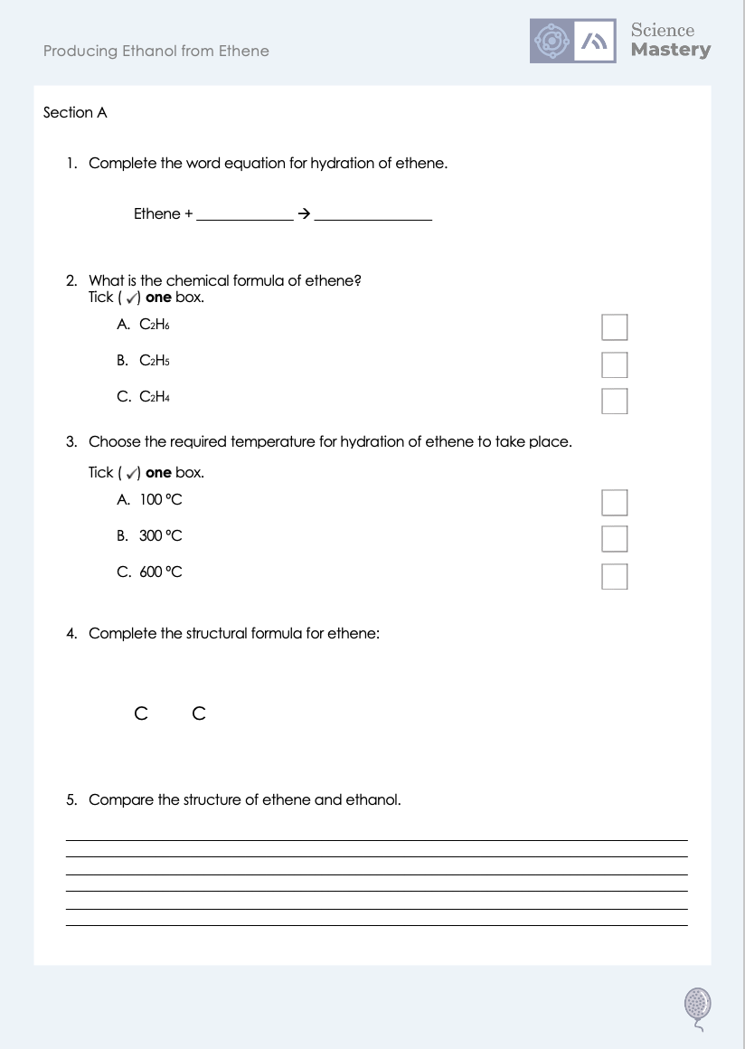
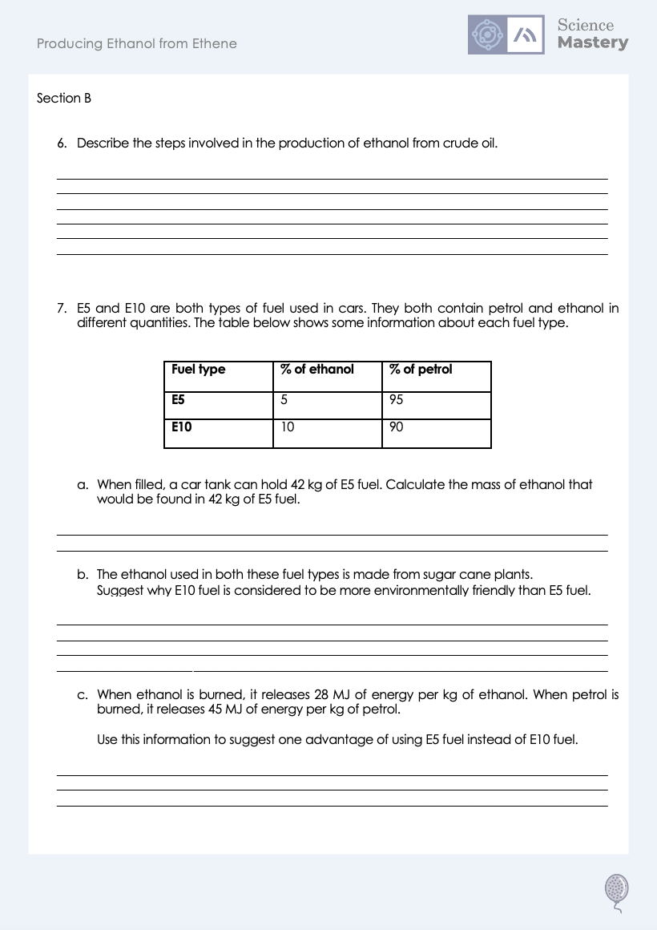
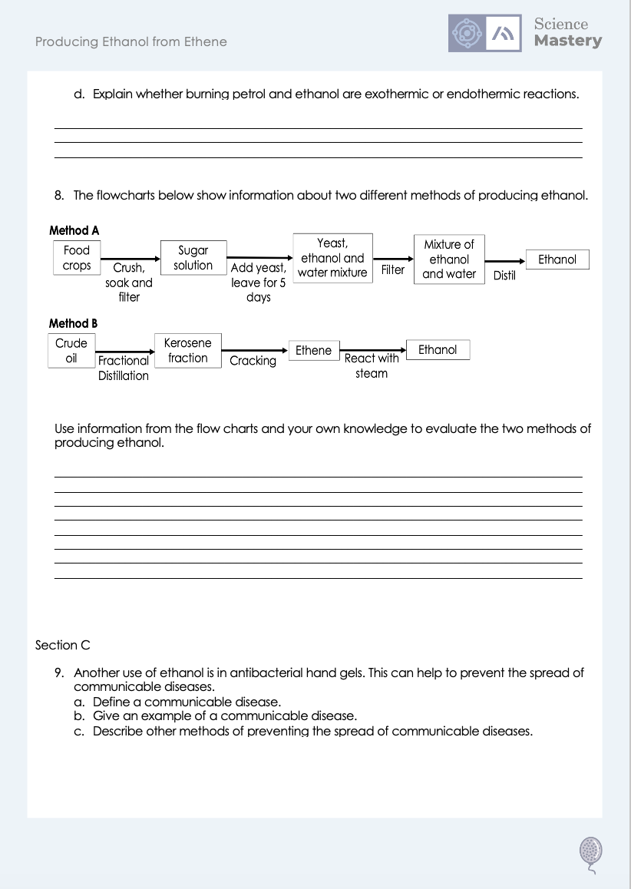
Worksheet

Slide 21
Answers
1. Ethene + steam (water) → ethanol
2. C₂H₄
3. B - 300 ºC
4.
H
H
C C
H
H
5.
Ethene and ethanol both contain 2 carbon atoms
Ethene contains 4 hydrogen atoms, whereas ethanol contains 5 hydrogen atoms and a hydroxyl group
Ethene contains a C=C double bond, whereas ethanol contains only single bonds

Slide 22
Answers
6.
Crude oil is fractionally distilled to separate it into fractions
Larger hydrocarbon fractions are broken up into smaller alkanes and alkenes (such as ethene) by cracking
Ethene can then be reacted with steam/hydrated to produce ethanol
7a. 5 % of 42 kg = 2.1 kg
7b. It contains more ethanol, so more sugar cane is used. This means that more carbon dioxide is absorbed when the plants are growing.
7c. As E10 contains more ethanol, it would release less energy per kg of fuel, so a tank of fuel would not last as long/be able to travel as far.
7c. They are both exothermic (combustion) reactions as they both transfer energy to the surroundings.

Slide 23
Answers
8. Method A
Advantages:
renewable resource/raw material
less energy required
carbon dioxide absorbed when plants are growing
low safety risk
easy processes, less technology needed
Disadvantages:
Process is slow
More steps are involved
Ethanol is impure
More land used for growing crops for fuel instead of food
Method B
Advantages:
fewer steps involved
ethanol produced is pure
Disadvantages:
non- renewable resource/raw material
energy intensive (high temperatures required)
Plus a justified conclusion

Slide 24
Answers
9a. Diseases caused by pathogens.
9b. Cholera, HIV, TMV, measles, salmonella, gonorrhoea, malaria, athlete’s foot
9c.
Sterilising water with chemicals or UV light
Cooking food thoroughly
Disinfecting surfaces
Vaccinations
Using barrier contraception methods

Slide 25
Answer the questions below.
Choose the term for what happens when ethanol is made from ethene.
A. Hydration
B. Hydrogenation
C. Fermentation
✓
What is a disadvantage of making ethanol from ethene?
A. Ethene is obtained from sugar cane so is renewable
B. Ethene is obtained from crude oil so is non-renewable
C. Ethene is obtained from biofuels so is renewable
✓
What is an advantage of producing ethanol from ethene?
A. It produces ethanol much more quickly than fermentation
B. It is an energy intensive process
C. It requires high temperatures and a catalyst
✓
Notes:
Q1. Answer: A
If students answer B, they have made the common mistake of confusing hydration and hydrogenation. If students answer C, they are not clear that ethene is not involved in fermentation. To fix-it, review the steps involved in each method of ethanol production.
Q2. Answer: B
If students answer A, they have confused the raw material for fermentation and hydration. If students answer C, they are not clear on what a biofuel is. To fix it, review the advantages and disadvantages of each method of ethanol production.
Q3. Answer: A
If students answer B, they have identified a disadvantage rather than an advantage. To fix it, review why energy intensity would be a disadvantage. If students answer C, they have simply stated the conditions rather than an advantage, which is a common mistake when answering exam questions on this topic. To fix it, review the advantages and disadvantages of each method of ethanol production.

Slide 26
Lesson C5.1.9
What was good about this lesson? | What can we do to improve this lesson?
Send us your feedback by clicking this link
or by emailing sciencemastery@arkonline.org
Thank you!

